Slide 1
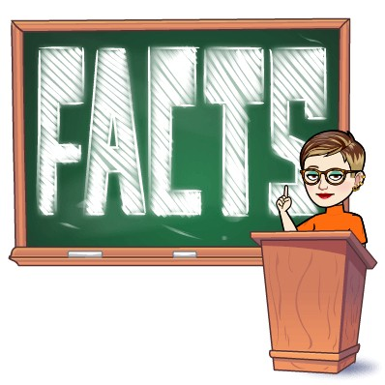
Digital Citizenship Lesson: Hoaxes and Fakes
Glenn Hills Middle School
Ms. A. New, M.Ed., Library Media Specialist
Source: Common Sense Media

Slide 2
Essential Question
How can you avoid being fooled by fake videos and other information online?

Slide 3
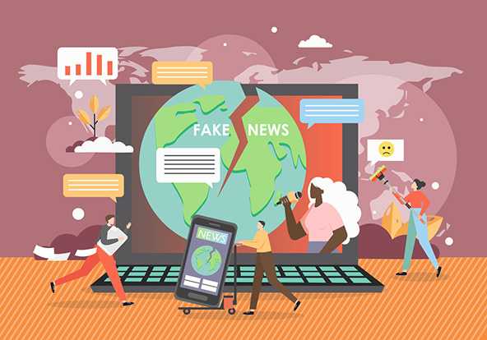
Learning Objectives
Define "misinformation" and explore the consequences of spreading
misinformation online.
Learn how to use lateral reading as a strategy to verify the accuracy
of information online.
Apply lateral reading to examples of questionable videos to
determine their accuracy.

Slide 4
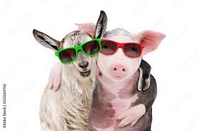
Pig Rescues Baby Goat
Did you ever see the amazing story of the pig who saved a baby goat
from drowning?
How does this story make you feel?

Slide 5
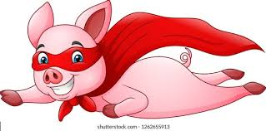
Petting Zoo Hero
Now, lets watch an amazing story that was captured on video!
How do you feel now knowing this video is fake?
As you can see, the comedian Nathan Fielder shows how easy it is to make a fake video that could potentially go viral.

Slide 6
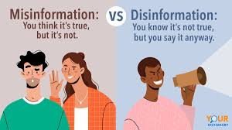
Key Vocabulary
The video you just watched is an example of disinformation – false or inaccurate information intended to deceive
If you shared this video or other information that is false, even if you don't intend to deceive anyone, you are sharing misinformation – false or inaccurate information, especially that which is intended to deceive.
Social media and the internet make it easy to share disinformation and misinformation.

Slide 7
Connecting To Real Life
Though the video we watched is an example of disinformation, it is just meant to be funny and to make people laugh. However, what if it was something more serious, like a fake news story or false information about an important event, like a natural disaster or a pandemic or an election? What ramifications might that have?
Disinformation and misinformation can have big consequences. It can:
increase tension and anger between groups of people.
damage individuals' or groups' reputations.
affect the outcomes of elections.

Slide 8
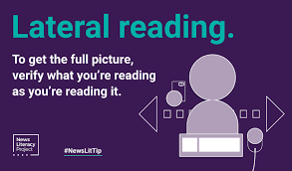
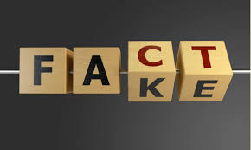
Key Vocabulary
Lateral Reading
A method of determining credibility of online information in which you open multiple tabs to search for other information to validate the site’s claims.
There's so much information out there, and we're consuming it so fast. It's easy to get duped. Today we're going to practice a strategy that will help you tell misinformation from credible information, whether it's fake videos or other questionable information you encounter.

Slide 9
Read Laterally For Accuracy
Watch the Crash Course video excerpt and answer the video questions as you go. If you’re in a group, you can share notes and responses.
What does Green mean when he says “information does not just appear” on the Internet?
What is the first question John says we must ask ourselves about things we see online?
Why is reading a website vertically not a great way to determine reliable information?
What is lateral reading, and why is it more effective than vertical reading to determine reliable information?
Where should you go when you read laterally?

Slide 10
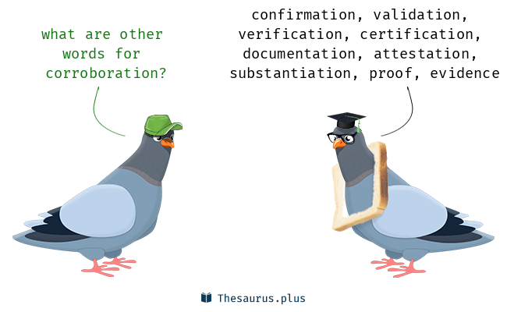
Key Vocabulary
Corroboration
additional source(s) that confirm or support the claims of a news story, article, or piece of information.

Slide 11
Snowboarder Girl Chased By Bear
Using lateral reading, determine whether this video is a hoax. Using the chart on the next slide, provide corroboration from trustworthy resources you can find. (This means you might not record every source you look at.) Be sure to avoid ads, sponsored links, and opinion pieces in your lateral reading. If you’re in a group, each group member can select a different resource to explore.

Slide 12
Using Lateral Reading
Corroborating Source (link or citation) | Evidence (1-2 ideas of how the source validates or debunks)
I determine the information in the video is :
_____a hoax _____real, because_______________________.

